Slide 1



Transition to
College
Notes:
Welcome everybody, in this talk, we will be looking at the transition from year 11 to college.
There is a worksheet to complete with this talk, I shall tell you when to fill out each task.

Slide 2
WHAT’S IN IT FOR ME?
Learn what Post-16 qualifications there are
Find out the differences between Post-16 providers
Learn what support is available for Post-16
Understand what you can do after Post-16
Notes:
In today’s session, you’ll learn about:
Different Post-16 qualifications
Find out about difference Post 16 providers
Look at the support available at college.
And Understand what different progression routes you can take after college

Slide 3


OPTIONS AFTER GCSEs
Fulltime Education
School Sixth Form
What will you do?
Post-16/ Further Education
College
Apprenticeship
Part-time Work alongside Education
Volunteering
Notes:
OPTIONS AFTER GCSEs
(You can: CLICK for each option)
After your GCSEs,
You are required to be in full-time education until you are 18
This can either be at a sixth form, college, or as an apprenticeship – this is called post-16 or Further Education
Outside of studies, you may also wish to work part-time or volunteer
This is all part of the Governments policy on ‘Raising of participation age to 18’ – this is what the government say you should be doing and you can choose any of the above.
Source: Career choices at 16 https://nationalcareers.service.gov.uk/careers-advice/career-choices-at-16

Slide 4
Masters
PRE-16 QUALIFICATION TABLE
Degree
Level 7
Higher Education
University
Third Year
Post-16 Progression
Apprenticeship
Level 6
Second Year
Higher
Level 5
First Year
Apprenticeship
Level 4
Advanced Apprenticeship
Further Education
Level 3
A-Levels
T-Level
V-Level
BTEC
Level 3*
Intermediate Apprenticeship
Year 10/11
Level 2
GCSEs
BTEC
Level 2
Notes:
POST-16 OPTIONS
(Click for animation) You are currently completing GCSEs which are a Level 2 qualification.
After Year 11, (click for animation) you will progress onto Level 3 where you will complete one of these qualifications. You will do this for Year 12 and 13
After this, education is optional. (click for animation) You can progress onto Higher Education; this includes qualifications such as university
For post-16 study, you can also do an apprenticeship, and then progress onto a higher and degree apprenticeship – the equivalent to university
We are not going to be talking about apprenticeships today, and will instead be focusing on A Levels, T Levels and BTEC Level 3.
Just as a heads up, by the time it is time for you to chose your Post-16 options, they might look slightly different. The reason is that BTECs are slowly being phased out to be replaced with a new qualification called V Levels.

Slide 5
POST-16 OPTIONS
A-Level
T-Level
BTEC Level 3
Subject-based qualifications.
You pick 3 or 4 school subjects
Vocational subjects designed by employers.
You pick 1 subject which is the equivalent of 3 A-Levels.
Vocational subjects.
Sat with A-Levels, or as a standalone which is the equivalent of 3 A-Levels.
What are they?
How long do they take?
2-year qualification completed in Years 12-13 after your GCSEs
Where do I study them?
At a School Sixth-Form, College, or a Sixth Form College
Notes:
LEVEL 3 OPTIONS
The qualifications you can take at college currently are A levels, T-levels, and BTECs,
What are they?
(Click for animation) A-Levels are subject-based qualifications. You choose either 3 or 4 different school-based subjects
(Click for animation) T-Levels are vocational subjects that have been designed by employers. You choose 1 subject that is the equivalent of 3 A-Levels
(Click for animation) BTECs are vocational subjects for those interested in a particular sector. They can be sat alongside A-Levels as the equivalent to 1 A-Level, or as a standalone subject which is the equivalent of 3 A-Levels.
There is also a new qualification being developed called a V-Level. These will likely be sector specific like a T-Level, but the same size as an A-Level so you can take more than one or mix with A-Levels. We are currently waiting for more information to be released about the launch of V-Levels.
How long do they take?
All three of these are 2-year qualifications that are completed in Year 12 and 13
Where do I study them?
Depending on your area, they can be sat at a sixth form or a college. Traditionally, A-Levels are completed at school sixth forms, with the vocational qualifications being done at a college. But this is not set in stone.
For TASK 1 on your worksheet, take 1 minute to match the qualification type to the description.

Slide 6
POST-16 OPTIONS
A-Level
T-Level
BTEC Level 3
All GCSE subjects, with some new e.g.:
Psychology
Law
Film Studies
Engineering
10 industry areas with over 20 subjects e.g.:
Health and Science
Digital
Creative and Design
Education and Early Years
Industry subjects e.g.:
Sport
Protective Services
Hair and Beauty
Hospitality
What can I study?
Graded A*-E - mainly exams.
You can do an EPQ which is a research project of your choice.
45-day industry placement.
Exams A*-E, and practical assessments
Distinction/ Merit/ Pass.
Distinction/ Merit/ Pass.
Coursework, practical assessments, and exams.
How are they assessed?
Notes:
LEVEL 3 OPTIONS
Click for each point
What can I study?
A-Levels are more school-based subjects. You will be able to select any of the GCSE subjects, with some new subjects such as the ones on screen
T-Levels relate to 10 different industry areas with over 20 subjects across the area including the ones on screen
BTECs are also focused on industry with subjects such as the following.
How are they assessed?
A-Levels are assessed predominantly through exams, graded from A* (highest) to E (lowest). In addition, you could also complete an EPQ – an extended project qualification. This is a research project of your choosing relating to one of your subjects. This is an additional qualification that can support a university application
T-Levels have a mandatory 45-day industry placement that must be completed to pass the course. Part of the T-Level is exam-based like A-Levels, graded A*-E, with another part relying more on practical assessment with a grade of Distinction/ Merit/ Pass
BTECs also use Distinction/ Merit/ Pass. Assessment type varies based on subject, but they can be through coursework, practical assessments, and exams.

Slide 7
POST-16 PROGRESSION
A-Level
T-Level
BTEC Level 3
Higher Apprenticeship
University
Full-time job
Higher Apprenticeship
University*
Full-time job
*Most universities, but check specific requirements
What can I do after?
Entry requirements depend on the provider.
Typically, five GCSEs at grade 4 including Maths and English.
Some may need a specific subject e.g., French GCSE for a French A-Level
What GCSEs do I need?
Some require you to start on Level 2 to build up your knowledge e.g., Trades, Hair and Beauty, Hospitality
Notes:
LEVEL 3 OPTIONS
Click for each point
What can I do after?
For A-levels, you can progress onto a higher apprenticeship, university, or go straight into full-time work
This is the same for T-levels and BTECs, but not all universities accept these, so it is best to check with a universities’ specific criteria. Most UK universities do however accept these.
What GCSEs do I need?
Entry requirements depend on the college or sixth form. At a minimum for Level 3 qualifications, you typically need 5 GCSEs at grade 4 including Maths and English. Some subjects may also require you to have sat a specific GCSE subject, such as having a French GCSE to study a French A-Level. Make sure you are checking the providers websites as some may prefer higher grades at 6 and above.
Some subjects may want you to start on a Level 2 course before progressing onto the Level 3. This is because, they may require you to learn brand new skills and subject knowledge. So, to give you a good base of knowledge, you would start on the Level 2 before moving onto the Level 3.

Slide 8

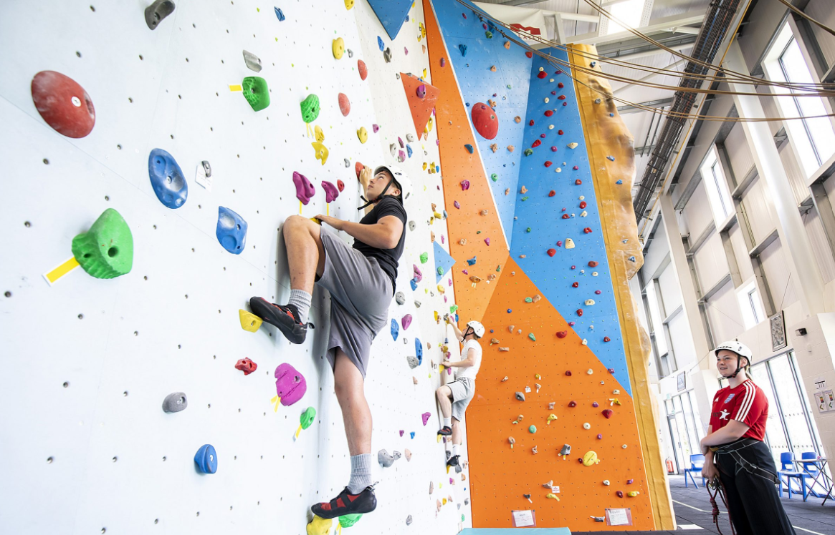
WHAT IS POST-16 LIKE?
Timetable dependant on course (16+ hours)
Timetable for T-Levels / Apprenticeships may differ due to work placement
Student Union and Career’s Hub to provide support and information
Clubs, trips, enrichment activities, cafés, libraries
Notes:
Now, let’s have a closer look at what college is like.
Your timetable will depend on the type of course you have chosen but you will have around 16+ hours of lessons per week. Some days may be very full whereas for other days, you might be coming in for just one class. Many students use the flexibility to take on part-time jobs.
If you have chosen a T-Level or an Apprenticeship, your timetable will vary to include your work placement.
On to facilities and the more social and extra-curricular aspect of college. At College, there are various Student Support Services; you’ll be supported by a student union and a career’s hub. They provide advise and information on a personal level but also regarding careers, apprenticeships and higher education.
Clubs and Societies – Some sixth forms, colleges or training providers will have a students union with lots of clubs and societies on offer. Others may only offer one or two. However it is set up, clubs and societies can be a great way to make new friendships and to meet people with common interests.
Examples: Barton Peveril College has a Q-Xtra programme, which are clubs and programmes you can join outside of your studies. These rage from weekly mindfulness sessions, sports clubs like badminton and Basketball and learning British Sign Language, to cookery classes and stand up comedy.
In sum, your college may be organising clubs, trips, and enrichment activities that you can participate in.
Regarding facilities, in your free periods or study breaks, you may be sitting in the cafes or libraries, studying together with your friends, or have a workout session in a gym.
Picture 1 taken from: https://barton-peveril.ac.uk/courses/chemistry/
Picture 2 taken from: https://www.sparsholt.ac.uk/facilities-gallery/

Slide 9
A DAY AT POST-16
MONDAY
TUESDAY
WEDNESDAY
THURSDAY
FRIDAY
08:30
INDEPENDENT STUDY
Subject 3
Subject 1
INDEPENDENT STUDY
Tutor
09:30
INDEPENDENT STUDY
Subject 4
Subject 4
INDEPENDENT STUDY
Subject 1
10:30
BREAK
11:00
Subject 1
Subject 2
Subject 2
Subject 4
Subject 4
12:00
Subject 2
INDEPENDENT STUDY
Enrichment
Subject 1
INDEPENDENT STUDY
13:00
LUNCH BREAK
13:30
Subject 3
Enrichment
INDEPENDENT STUDY
Enrichment
Subject 3
14:30
INDEPENDENT STUDY
INDEPENDENT STUDY
Subject 3
Subject 2
INDEPENDENT STUDY
Notes:
POST-16 OPTIONS
Moving on to an example of what your timetable could look like.
In this case, the student has chosen 4 subjects for their A-levels.
As you can see, they’ve got 3 sessions per day but also lots of independent study sessions, where they can do some studying in the library, or doing coursework or having a break with their friends in the canteen or a cafe.
They’ve also got some Enrichment activities in their timetable on Tuesday, Wednesday and Thursday. They might be part of a sports club, a choir or a band.
On Friday, during period 1, they’ve got a session with their tutor. You’ll be given a tutor, supervisor or other member of staff in your sixth form, college, training provider or workplace who is there to support you and answer any questions you have. Make sure to note down their name and contact details, in case you have questions, need adjustments and don’t know where to go, or just need a chat to a friendly face. College tutor time does not take place every day and, while it is often held early in the morning (e.g., 08:25), can also take place at a later point in the day. During this time, the focus often lies on student support, academic progress, and personal development.
Just a note on the length of the day – this is just an example of what your day could look like, but obviously different colleges have slightly different timings. Some colleges days will run til 4/4:30, so it can be a long day compared to school. It’s also worth keeping in mind that your day will be longer or shorter depending on how far you need to commute to get to your Post-16 provider.

Slide 10
POST-16 PROVIDERS
Attached to a secondary school – not all schools have a sixth form
They average around 50-150 students across Y12 and 13
Mainly offer A-Levels, with some having BTECs and T-Levels
School Sixth Form
Separate provider of Post-16 qualifications
Larger than sixth forms - the biggest have more than 7,500 students
Can offer A-Levels, T-Levels, BTECs and host Apprenticeships
College
Similar to sixth forms but separate from secondary schools
They offer A-Level and some BTECs
An example for a Sixth Form College is Peter Symonds in Winchester
Sixth Form College
There is no institutional preference – universities care about the qualification
Notes:
Let’s have a look at where you can study post-16 education.
A Sixth Form is attached to a secondary school. However, not all schools have a sixth form attached to them. On average, Sixth Forms can accommodate 50-150 students and they mainly offer A-Levels but some also offer BTECs and T-Levels.
A College is not attached to a secondary school but is its own institution. Colleges are much larger than sixth forms with the largest hosting 7,500 students although there are also smaller ones. Colleges offer a wider range of courses, you can do A-Levels, T-Levels, BTECs and apprenticeships.
There is also a third post-16 provider, namely a “Sixth Form College”. In terms of its structure and what courses they offer, it is very similar to School Sixth Form, but larger. However, they are not attached to a secondary school and are an independent institution like Colleges. They offer A Levels and some BTECs, like School Sixth Forms do.
It’s worth saying that there is no institutional preference. Universities care about the qualification itself - whether it’s an A Level, T Level, or BTEC - and the grades achieved, not if you went to a Sixth Form, College, or Sixth Form College

Slide 11
CHOOSING YOUR COURSES
You’ll need to consider
Career goals
Hobbies & Interests
Progression
How you learn
Now you need to research your local colleges
Notes:
CHOOSING YOUR COURSES
To choose what you want to study at college, you’ll need to consider a few things.
Career Goals (click for animation) – if you have a particular career in mind, you might want to look into what qualifications you need in order to get there
Hobbies and Interests (click for animation) – consider your hobbies and interests, you want to choose subjects you’ll enjoy
Progression (click for animation)– do you want to go to uni or into an apprenticeship? Is the course you’re considering going to help you get there?
How do you lean (click for animation) – do you prefer learning theories and writing essays, or do you work better in a practical way? This could help you choose what type of course will work best for you.
I’ll now give you 2 minutes to complete task 2 by filling in the boxes on your worksheet, making note of what your career goals are, what you would like to progress to, your hobbies and interests, and how you learn best.
(Click for animation) Once you’ve got an idea of the sort of subjects you’d like to study, you’ll need to check out your local colleges
TASK 2 on your worksheet is to fill in these categories for yourself, making note of your personal career goals, how you might like to progress, your hobbies and interests, and how you like to learn. You’ve got just under 2 minutes

Slide 12

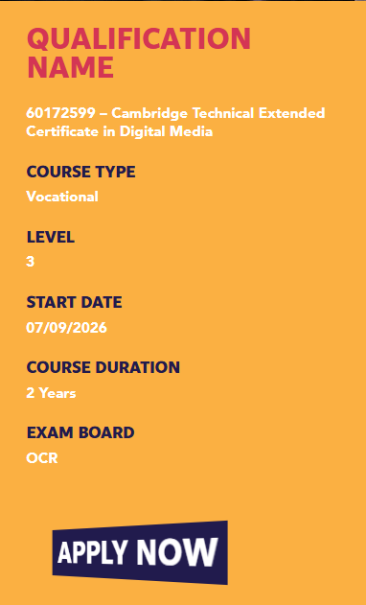
Make a note of:
Course full title
Entry requirements
What you’ll study
How it’s assessed
Progression routes
Notes:
CHOOSING YOUR COURSES
This is an example from Richard Taunton Sixth Form College’s website, all college websites will vary slightly so don’t worry if the one you’re applying to looks a bit different.
On all college websites, you’ll be able to read about individual courses that they offer.
When doing this, there are some important bits to make a note of to help you make an informed choice about which course or courses to choose.
You’ll need to make a note of:
The full course title (click for animation) – this included the long number and type of course, e.g. Cambridge Technical. Extended Certificate.
Entry Requirements (click for animation) – some courses might ask for specific GCSE subjects or higher grades.
What you’ll study (click for animation) – This will help you choose the right course for you
How it’s assessed (click for animation) – Think about how you work best, do exams work for you? Or do you prefer coursework? Understanding this can help you make an informed choice.
Progression routes (click for animation) - check out where this course can take you, it’s important to check if this course will help you progress into you chosen career or to university.
If you’re struggling to find information on their website, it’s always worth emailing the college, they’re always happy to help new students. Remember, they want you to apply!

Slide 13
CHOOSING YOUR COURSES
At college, you will have 3 subject slots to fill
Example 1
Example 2
Example 3
Example 4
Slot 1
A Level – Fine Art
BTEC Diploma – Sports and Exercise Science
BTEC Extended Diploma – Performing Arts
T Level - Legal Services
Slot 2
A Level – English Literature
Slot 3
A Level - Psychology
BTEC Extended Certificate- Health &Social Care
Notes:
COLLEGE APPLICATIONS
Depending on what subjects you choose, your timetable might look different.
Some Btecs will take up 1, 2 or 3 slots in your college timetable. These courses are designed for students who want to gain a more in-depth knowledge of that particular subject.
How do you know the difference? There are lots of different BTEC providers, just like GCSE exam boards, so they differ slightly. Generally, they will say on the college website how much time each course takes up but if you’re confused, talk to your teacher or email the college directly.
The government are currently creating a new set of qualifications called V Levels too. Although we don’t know much about them yet, they will likely be similar to the current Btec option and may replace Btecs in certain colleges.

Slide 14
h
COLLEGE APPLICATION
APPLY NOW
Personal Contact Details
Name
Address
Email address
Parents/Carers contact details
Select Your Courses
Chosen course names
Up to 5 different options
You may be asked to choose an enrichment activity too
Your Current Qualifications
Your GCSEs including exam board name
Your predicted grades
You may also add details of other qualifications, like D of E or music exams
Personal Statement
Why you want to go to this college
Reasons you would be a good student
You can talk about your skills and extra curricular activities here
If you’re not sure on any of this – talk to your tutor or careers advisor
Notes:
COLLEGE APPLICATION
Now you’ve got a good idea of your course options and the different names, you’re ready to start your applications.
You can apply to multiple colleges and each application form may differ slightly, for all applications though, you will need:
Your Personal Contact Details and the details for your parents/ carers
Your course choices – remember, you’ll need the full name of the course, you might also need to provide extra options too
Your current qualifications – you’ll need to provide your GCSE information, including the exam boards and your predicted grades

Slide 15
h
RECEIVING AN OFFER
Application Reviewed
Invitation to Interview
Offer is made
Your offer from the college will specify which GCSEs you will need, and at what grade
“I have an unconditional offer. This means I don’t have to worry about my GCSEs.”
Notes:
RECEIVING AN OFFER
After applying, you will then be invited to an interview.
If successful, you will receive an offer from the college.
This will specify which GCSEs you will need and at what grade.
Some colleges may give you an unconditional offer, some people think this means they don’t have to worry about their GCSEs.
This is not the case.

Slide 16
h
RECEIVING AN OFFER
An Unconditional Offer means you will have a place at the college, but you will still need to meet the entry requirements for the subject and level you want to study
These are the typical minimum requirements – check the college website!
Level 3
Minimum of 5 GCSEs grade 4 and above including English and Maths
Level 2
Minimum of 4 GCSEs grade 3 and above including English and Maths
You will need to re-sit Maths and/ or English to get a grade 4 before you can progress to Level 3
Level 1
Minimum of 4 GCSEs grade 1-3 including Maths and English
You will need to re-sit Maths and/ or English to get a grade 3 before you can progress to Level 2, or grade 4 for Level 3
Notes:
RECEIVING AN OFFER
An Unconditional Offer means you will have a place at the college. However, you will still need to meet the entry requirements for the subject and level you want to study. If you don’t meet those requirements, you will be given a place on a lower level, depending on your GCSE grades. For example, if you apply for a Level 3 Art and Design course but get a grade 3 in English, you will get a place on a Level 2 Art and Design course, and need to re-sit your English GCSE for a grade 4.
Below are the typical minimum requirements for each level. Make sure to check the college website as some may ask for higher grades.
If you do not get a grade 4 or above in Maths and/ or English, you will need to re-sit these GCSEs before you can progress.
On your worksheet, complete TASK 3 by filling in the blanks. You have 1 minute.

Slide 17

What support can you get at Post-16?
Notes:
SUPPORT AT COLLEGE
Colleges will offer support in lots of different ways, just like your school.

Slide 18
STUDENT SUPPORT SERVICES
Mental Health
Academic Support
Financial Support / Guidance
Careers Support/ SUN Progression Mentor
Notes:
Sixth Form / College support: 2 mins
You will be able to access student support services whether you are at a college, sixth form, or on an apprenticeship. These will include support for mental health, academic support, financial support and guidance, and careers support. It will look slightly different in every sixth form / college / training provider / workplace but it is useful to familiarise yourself with where you can access these services when you arrive.
Here are some examples from local colleges of what you may have access to (remember, not all sixth forms/colleges/training providers will have all of these examples):
Please complete TASK 4 on your worksheet by filling in the table with each of the support services available to students.
Mental Health – drop-in sessions with trained staff, or external support agencies or charitable organisations, access to counselling.
Financial – Bursary (pot of money which can be accessed if facing financial barriers to attending your chosen course(s), free college meals, signposting to external organisations who can provide further support, financial support for travel costs
Academic – Specialist support and guidance to develop your study skills, assistance with completing assignments, time management and revision, exam support
Careers support – Drop-in advice clinic, one-to-one careers guidance, CV writing support, events with local universities, education providers and employers, support finding an apprenticeship or job
You're likely to have an induction at whichever sixth form, college, workplace or training provider you choose to attend which can be a good place to explore the support services that are available.

Slide 19
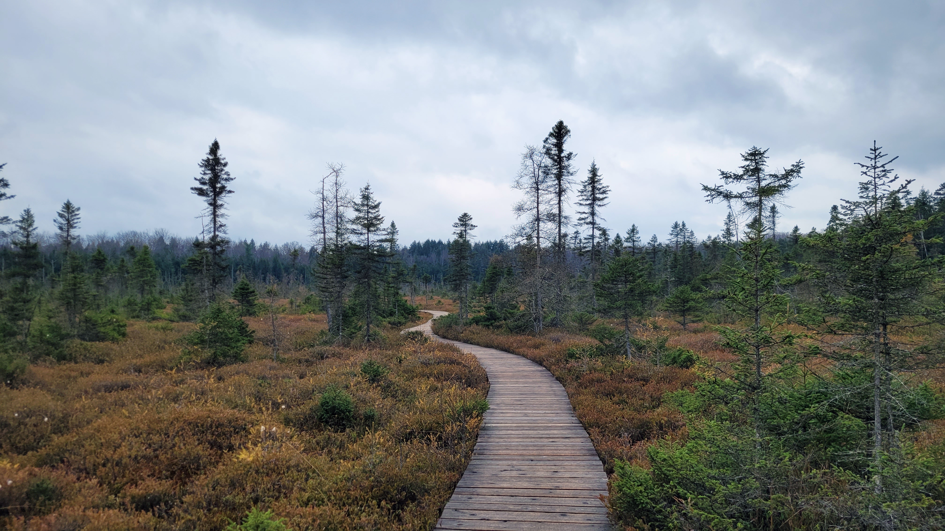
What can you do after Post-16?
Notes:
We are now going to look at the different pathways you can take after college.

Slide 20
PROGRESSION AFTER POST-16
Level 7
Masters
Degree
Level 6
University
Year 3
Apprenticeship
Higher Education – 18+
Level 5
University
Year 2
Higher
Level 4
University
Year 1
Apprenticeship
Year 12-13
Level 3
A Level
T Level
BTEC Level 3
Advanced Apprenticeship
Year 10-11
Level 2
GCSEs
BTEC Level 2
Intermediate Apprenticeship
Notes:
PROGRESSION AFTER COLLEGE
After Post-16, education is optional. You can progress onto Higher Education; this includes qualifications such as university or a degree apprenticeship. – click for animation

Slide 21

Next Steps
Notes:
So, what do you do next?

Slide 22
YOUR YEAR 11 TIMELINE
Spring Term
Start GCSE Exams
Summer Holidays
Collect results and see if you met the conditions for College / Sixth Form / Apprenticeship
Autumn Term
Apply for College / Sixth Form / Apprenticeship
Revise for GCSE Exams
Summer Term
Finish GCSE Exams and wait for Results Day
Notes:
Your Year 11 Timeline
This is what your year 11 timeline will look like. At the beginning of year 11, you should already have an idea of what you would like to do after school. Remember, lots of colleges have open days in OCTOBER, so it’s worth visiting them at the beginning of the year.
In the Autumn Term: You should be starting revision in autumn term for your GCSE exams, as well as applying to the colleges, sixth forms, or apprenticeships that you’re interested in. Although it’ worth noting that you may apply for apprenticeships throughout the year, not just during autumn term.
In the Spring term brings the start of your GCSE exams and ‘crunch time’ for the last of your revision.
In the Summer Term: You’ll finish off your exams and wait for results day to see how you have done.
During the summer holidays you’ll collect your exam results and find out if you got a place at the college / sixth form or if you got the apprenticeship you applied for.

Slide 23
YOUR YEAR 11 TIMELINE
Did you meet your entry requirements?
Oh no… you may have to take a slightly different course, or retake some of your exams whilst you start your post-16 studies
NO
YES
GCSEs are important and can impact your future qualification or job opportunities!
Great! You’re ready to start College/Sixth Form/Apprenticeship
Notes:
GCSEs are really important throughout your life. Not only can they dictate what post-16 qualifications you can take, they can also affect what jobs you get later in life. In order to get certain jobs, apprenticeships and university courses, you may need to have passed certain subjects at GCSE, including English and Maths. It’s important you try and do your best now, otherwise you might have to retake these exams in future.
It’s good to note that each college, apprenticeship, sixth form or university is likely to have different entry requirements. This can include what GCSEs you need, and what grades you need to achieve.
Here are some examples of jobs that need GCSEs:
To become a paramedic you’ll need at least 5 GCSEs at grade 9-04 including English, Maths and Science.
To become a teacher you’ll need English and Maths GCSEs at grade 4 or above, and Science at grade 4 or above if you want to teach in primary school
To become a firefighter you’ll need grade 4 or above in English and Maths
Although there are other qualifications you can take, it will mean redoing maths and English (in the form of functional skills or another course) whilst also studying for you’re a Levels, BTEC, Apprenticeship or T Level. Sometimes you may even have to redo these exams later in life if you don’t achieve the grades you need now.

Slide 24


FOLLOW US
@southern_universities_network
www.sunoutreach.org
Resources available on our website:
  Higher Education Guides
  Games
  Mental Health Support
  Student Finance
  National Open Day Information
  Career Support

