Slide 1


UNDERSTANDING
Apprenticeships

Slide 2

WHAT’S IN IT FOR ME?
Understand what an Apprenticeship is
Know how to identify suitable apprenticeships
Know how to search for vacancies and their requirements
Notes:
In this session, you will learn:
What an apprenticeship is
What type of apprenticeship you should be looking for
Where and how to search for vacancies, and what you will need to do

Slide 3


OPTIONS AFTER GCSES
Full-time Education
Post-16/ Further Education
School Sixth Form
What will you do?
College
Apprenticeship
Part-time Work
Volunteering
Notes:
Before we explain what apprenticeships are, it is good to explain everything you can do after your GCSEs.
You are legally required to be in full-time education until you are 18. Study after GCSEs is often called Post-16 or Further Education
You can do this at a college, school sixth form, or as an apprenticeship
Alongside this, you may also volunteer or work part-time to gain more experiences, or just start earning money
Today, we will just be focusing on apprenticeships
Source: Career choices at 16 https://nationalcareers.service.gov.uk/careers-advice/career-choices-at-16

Slide 4

What is an Apprenticeship?

Slide 5
WHAT IS AN APPRENTICESHIP?
WORK
EARN
LEARN
Job with an employer
Practical experience in the workplace
Working 4 days a week
Minimum £8 per hour
Wage increases to the minimum wage for your age after first year
Varies based on level and employer
1 day a week study
Linked to a college, training provider or university
Supported by an Assessor
Notes:
WHAT ARE APPRENTICESHIPS
An apprenticeship can be summarised in three words: work, earn, learn.
Work
Apprenticeships are a real job with an employer
You gain practical experience and develop skills in the workplace alongside people that already do the job
You spend 4 days a week working full-time
Earn
On screen is the current minimum wage apprentices are paid
Wage increases to the minimum wage for your age after first year
Wage varies based on level and employer – some employers pay more as they want the best candidates
Learn
You spend the equivalent of 1 day a week studying
This will either be at a college, training provider, or university
You will be supported by an assessor, similar to how a teacher may be supporting you now

Slide 6
POTENTIAL EARNINGS
Apprenticeship Minimum Wage - £8 per hour
£8 is the standard minimum for all apprentices in their first year
21+ : £12.71
18-20: £10
Under 18: £8
After the first year, you are then entitled to the minimum wage for your age
Notes:
POTENTIAL EARNINGS
This is the standard minimum for all apprentices in their first year
After that point, you are then entitled for the minimum wage for your age
On screen is the current minimum wages for your age, so whatever age bracket you come under, that will be your new minimum wage after the first year of your apprenticeship

Slide 7

What Apprenticeship is right for you?
Notes:
Now you know what an apprenticeship is, we are going to have a look at how you can find the right apprenticeship for you

Slide 8
Masters
APPRENTICESHIP PATHWAY
Degree
Level 7
Higher Education
University
Third Year
Apprenticeship
Level 6
Second Year
Higher
Level 5
First Year
Apprenticeship
Level 4
Advanced Apprenticeship
Further Education
Level 3
A-Levels
T-Level
V-Level
BTEC
Level 3*
Intermediate Apprenticeship
Year 10/11
Level 2
GCSEs
BTEC
Level 2
You can do an Apprenticeship once you complete your GCSEs
You may start on an Intermediate Apprenticeship (Level 2)
Notes:
APPRENTICESHIP PATHWAY
In Year 10 and 11, you will complete your GCSEs or Level 2 BTEC qualifications. These are what we call Level 2 qualifications
After this, you can progress onto an Apprenticeship
Even though it is the same level as GCSE, you may start on an Intermediate Apprenticeship (click)
This is because, you could be starting something you have no prior experience in such as plumbing or barbering. So, you start on a lower level and work your way up from there

Slide 9
Masters
APPRENTICESHIP PATHWAY
Degree
Level 7
Higher Education
University
Third Year
Apprenticeship
Level 6
Second Year
Higher
Level 5
First Year
Apprenticeship
Level 4
Advanced Apprenticeship
Further Education
Level 3
A-Levels
T-Level
V-Level
BTEC
Level 3*
Intermediate Apprenticeship
Year 10/11
Level 2
GCSEs
BTEC
Level 2
Some may start on an Advanced Apprenticeship (Level 3) or do this after their Level 2
Notes:
APPRENTICESHIP PATHWAY
After your GCSEs, you may move on to Level 3, also known as Further Education or Post-16
Here, you will either complete A-Levels, a T-Level, V-Levels, or a BTEC Level 3
A Level 3 Apprenticeship is known as an Advanced Apprenticeship
Some of you may start at the Advanced Apprenticeship after your GCSEs, or progress onto it following the Intermediate Apprenticeship – it depends on what you are doing your apprenticeship in

Slide 10
Masters
APPRENTICESHIP PATHWAY
Degree
Level 7
Higher Education
University
Third Year
Apprenticeship
Level 6
Second Year
Higher
Level 5
First Year
Apprenticeship
Level 4
Advanced Apprenticeship
Further Education
Level 3
A-Levels
T-Level
V-Level
BTEC
Level 3*
Intermediate Apprenticeship
Year 10/11
Level 2
GCSEs
BTEC
Level 2
After Further Education, you have the option to progress to Higher Education
You can progress to a Higher Apprenticeship
Notes:
APPRENTICESHIP PATHWAY
Once you are 18, education is no longer a legal requirement, but you may wish to continue into higher education – this is what university comes under
You are also able to continue with the apprenticeship route to a higher apprenticeship (click)
This is the equivalent of the first two years of university

Slide 11
Masters
APPRENTICESHIP PATHWAY
Degree
Level 7
Higher Education
University
Third Year
Apprenticeship
Level 6
1 minute!
Second Year
Higher
Level 5
First Year
Apprenticeship
Level 4
Advanced Apprenticeship
Further Education
Level 3
A-Levels
T-Level
V-Level
BTEC
Level 3*
Intermediate Apprenticeship
Year 10/11
Level 2
GCSEs
BTEC
Level 2
You can progress all the way to a Degree Apprenticeship!
TASK 1
Fill in the apprenticeship levels
from Level 2-7
Notes:
APPRENTICESHIP PATHWAY
You can then continue with a degree apprenticeship, which is the equivalent of a Level 7 qualification!
(click) By following the apprenticeship route, you could be just as qualified as someone who goes to university
On your worksheet, complete TASK 1 by filling in the apprenticeship levels from level 2 up to level 7.

Slide 12
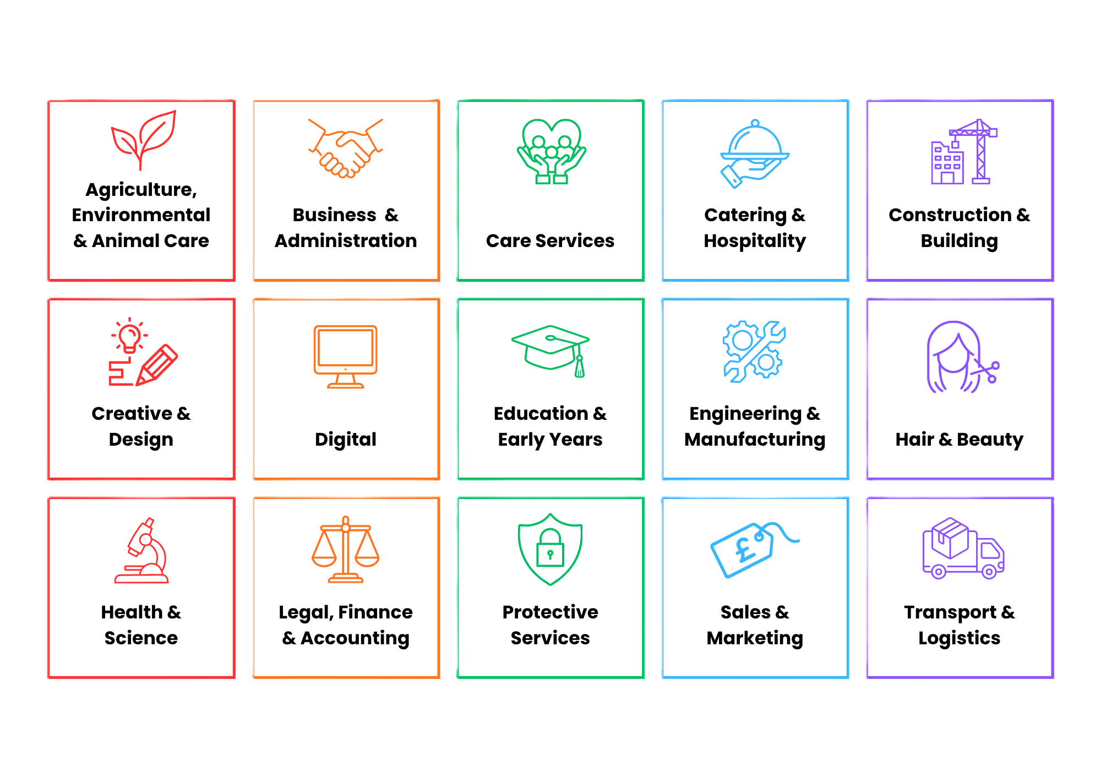
APPRENTICESHIP SECTORS
Notes:
APPRENTICESHIP SECTORS
When you search for apprenticeships, it is useful to start your research from the sectors that you are interested in.
There are lots of sectors to consider. It’s important to note that on different websites, apprenticeship sectors can sometimes be referred as routes or industries, but they essentially mean the same thing.
Also, as you can see on the slide, these sectors cover a wide range of different fields of work, not just the conventional construction and engineering-related apprenticeships.
https://apprenticeshipguide.co.uk/apprenticeship-category/industry-sectors/

Slide 13
APPRENTICESHIP SECTORS
2 minutes!
TASK 2
Match the Apprenticeship sector to the specific role
Notes:
APPRENTICESHIP SECTORS
Now, on your worksheet, complete TASK 2 matching the apprenticeship sector to the specific role. Take 2 minutes.

Slide 14

CHOOSING THE RIGHT OPTION FOR YOU
APPRENTICESHIPS
What are the pros/ cons?
1 minute!
Notes:
Choosing the right option for you-2 mins
Thinking about the benefits of different options is an important part of choosing a further education option after GCSEs
It is important to consider all of your options and start to weigh up what matters most to you
A great way to do this can be to start a pros and cons list
Talking to the person next to you, discuss what are the pros and cons of doing an apprenticeship?

Slide 15
CHOOSING THE RIGHT OPTION FOR YOU
APPRENTICESHIPS
Gain experience
Learn the skills employers want
Connect with employers
Earn money
Focus on career you want
Less free time with full-time work
Big change from school
Longer commute
Notes:
Choosing the right option for you
These are some of the ideas we came up with
Apprenticeships Pros
- Gain experience – great for the CV!
Earn money
Make connections with employers – chance to get a job after finishing your apprenticeship
Focus on what you want to do – if you know what career you want, apprenticeships allow you to just focus on that
Learn the skills employers want by learning in the workplace
Cons
Less free time with full-time work – you will be working 9-5 4 days a week, and studying all day on the fifth
Working full time is a big change from school – there may not be many people your own age
Longer commute - to do the apprenticeship you want, you may need to look further away

Slide 16

Search for Vacancies
Notes:
SEARCH FOR VACANCIES
Now you know what an apprenticeship is, and how to find the right apprenticeship for you, we are now going to look at where you can find apprenticeship vacancies.
The video on the next slide will show you where you can search for vacancies.

Slide 17
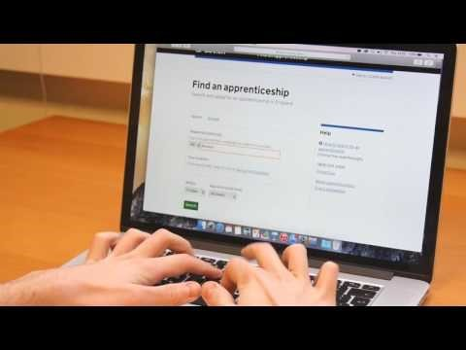
Notes:
WHAT NEXT? APPRENTICESHIP APPLICATIONS – SEARCH FOR VACANCIES
Video depicts using the find an apprenticeship gov.uk website - https://youtu.be/K0zgg1Gv-EU

Slide 18
LOCAL COLLEGES/ UNIVERSITIES
Dorset
Southampton
Winchester
Portsmouth/ IOW
Bournemouth and Poole College
Solent
University
Sparsholt
College
University of
Portsmouth
Brockenhurst
College
South Hampshire College Group
City of Portsmouth
College
South Hampshire College Group
Weymouth
College
Solent
University
Havant and South Downs College
Sparsholt
College
Rockley
College
University of
Winchester
South Hampshire College Group
Bournemouth
University
Brockenhurst
College
Basingstoke College of Technology
Isle of Wight
College
Notes:
WHAT NEXT? APPRENTICESHIP APPLICATIONS – LOCAL COLLEGES/ UNIVERSITIES
As well as the find an apprenticeship website, you could also look for apprenticeships directly with training providers
You can see the examples of local colleges and universities on screen depending on the area you are from

Slide 19

WHAT DOES AN APPRENTICE NEED?
EMPLOYER
TRAINING PROVIDER
APPRENTICE
All vacancies will come with an Employer, and Training provider.
You may need to find your own employer
Applying directly to a training provider doesn’t necessarily give you an employer
Notes:
WHAT DOES AN APPRENTICE NEED?
Before you can think about applying for an apprenticeship, it is important to consider what you will need. Click
To complete an apprenticeship, you will need an employer, and a training provider. They are separate entities who will work in partnership giving you the experience and training needed to qualify. Click
If you apply on the find an apprenticeship website, you will have both an employer and training provider. If successful, in your application, congratulations! You are an apprentice. Click.
If you only apply for a training provider, such as a university or college, this doesn’t mean you have an employer. You may apply and be offered a place, with the condition that you find your own employer.

Slide 20



GETTING AN EMPLOYER
Attend Employer Events
Find Employers and jobs on LinkedIn
Search on job sites like Indeed
Contact employers directly
Speak to connections
Careers & Apprenticeship Show
Bournemouth 11th March 2027
Employers may post opportunities here
Get a job with an employer then start an apprenticeship
Companies may have apprenticeship teams, or advertise on their website
Friends/ family, previous work experience
Notes:
GETTING AN EMPLOYER
If you need to get an employer, here are some ways you can get an employer
Attend Employer Events – this includes school careers fairs, or college/ university organised events
Another example is the Careers & Apprenticeship Show in Bournemouth. They invite local employers who offer career and apprenticeship opportunities
Find Employers and jobs on LinkedIn – you can also create an online CV and make it easy for employers to find you
Employers also post opportunities here
Search on job sites like Indeed – you can also find apprenticeships on job sites.
Some people start an apprenticeship after getting a job as a way of progressing their career
Contact employers directly – you can email, call, or visit employers in person with your CV
Lots of companies may have their own dedicated apprenticeship team. You can usually find this contact information on a company website. Others may also advertise their apprenticeships on their website
Speak to connections – sometimes it’s not what you know, but who you know!
This could be friends or family with links to employers, or any previous work experience
Apprenticeship training providers will also have links with employers to help you
It is National Apprenticeship Week every February. There are likely to be lots of events in your local area, and employers actively looking for apprentices.
Now take 2 minutes to complete TASK 3 by writing down 3 examples of how to get an employer.

Slide 21
GETTING AN EMPLOYER
Attend Employer Events
Find Employers and jobs on LinkedIn
Search on job sites like Indeed
Contact employers directly
Speak to connections
Careers & Apprenticeship Show
Bournemouth 11th March 2027
Employers may post opportunities here
Get a job with an employer then start an apprenticeship
Companies may have apprenticeship teams, or advertise on their website
Friends/ family, previous work experience
2 minutes!
Training providers will have links with employers
TASK 3
Write 3 examples of how to get an employer
NATIONAL APPRENTICESHIP WEEK 8th-14th February 2027
Notes:
GETTING AN EMPLOYER
If you need to get an employer, here are some ways you can get an employer
Attend Employer Events – this includes school careers fairs, or college/ university organised events
Another example is the Careers & Apprenticeship Show in Bournemouth. They invite local employers who offer career and apprenticeship opportunities
Find Employers and jobs on LinkedIn – you can also create an online CV and make it easy for employers to find you
Employers also post opportunities here
Search on job sites like Indeed – you can also find apprenticeships on job sites.
Some people start an apprenticeship after getting a job as a way of progressing their career
Contact employers directly – you can email, call, or visit employers in person with your CV
Lots of companies may have their own dedicated apprenticeship team. You can usually find this contact information on a company website. Others may also advertise their apprenticeships on their website
Speak to connections – sometimes it’s not what you know, but who you know!
This could be friends or family with links to employers, or any previous work experience
Apprenticeship training providers will also have links with employers to help you
It is National Apprenticeship Week every February. There are likely to be lots of events in your local area, and employers actively looking for apprentices.
Now take 2 minutes to complete TASK 3 by writing down 3 examples of how to get an employer.

Slide 22
KEY TAKEAWAYS
Work + Earn + Learn
80% Working, 20% Classroom
Level 2 - Intermediate
Level 3 - Advanced
Different sectors with a huge range of jobs
Vacancies on the gov.uk website
Have a Plan B
Notes:
KEY TAKEAWAYS
Work, Earn, Learn – you are employed, earning money, and you are gaining a qualification
You will spend 80% of your time working, and the other 20% in a classroom learning with your training provider
Level 2/ Level 3 – After finishing your GCSEs, you will either be looking at a Level 2 or Level 3 apprenticeship depending on the role and any prior knowledge or experience
Different sectors with a huge range of jobs
You can find vacancies on the gov.uk website – if you are applying directly to a college, you will need to find your own employer
Have a Plan B – apprenticeships are competitive,

Slide 23
WHAT NOW?
1. Research apprenticeship sectors and jobs
2. Set up notifications for your sector of interest
3. Check local colleges and sixth forms for your plan B
4. APPLY!
Notes:
If you are interested in apprenticeships or want to do one after your GCSEs, here are some steps you should take:
Research apprenticeship sectors and jobs – there are a range of sectors with lots of jobs available
Once you know what sector or job you are interested in, set up to receive notifications on the find an apprenticeship website
Check local colleges and sixth forms for your plan B. Apprenticeships are competitive, you should also apply for a course at college or sixth form in case you can’t get an apprenticeship
Once an opportunity comes up – apply!

Slide 24


FOLLOW US
@southern_universities_network
www.sunoutreach.org
Resources available on our website:
  Higher Education Guides
  Games
  Mental Health Support
  Student Finance
  National Open Day Information
  Career Support

